Slide 1


RAScatter: Achieving Energy-Efficient Backscatter Readers via AI-Assisted Power Adaption
Kai Huang, Ruirong Chen, Wei Gao
University of Pittsburgh
IoTDI 2022
Notes:
Hello everyone. I am Kai Huang from University of Pittsburgh. It’s my pleasure to present our work, “RAScatter: Achieving Energy-Efficient Backscatter Readers via AI-Assisted Power Adaptation”. This is a joint work with my lab mate Ruirong Chen and my advisor Dr. Wei Gao at University of Pittsburgh.

Slide 2
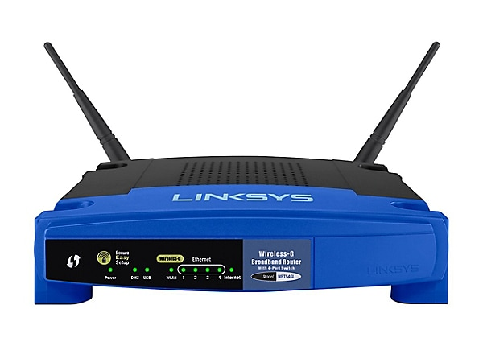



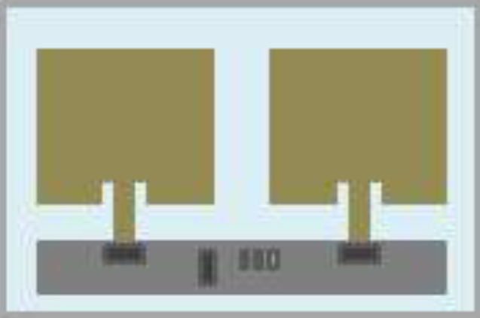
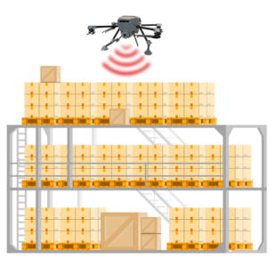



Backscatter Communication
Backscatter communication
The reader transmits strong RF signals
Tag harvests RF energy
Tag modulates incoming RF signals
RF Sources
ON/OFF
The reader’s energy cost is high! (Tx power > 1W)
Batteryless device
Backscatter Readers
Typical applications on mobile devices
Smart agriculture
Smart health
Smart inventory management
Notes:
Backscatter techniques have enabled batteryless communication. [x] In typical backscatter systems, a reader device continuously transmits strong RF signals. [x] The batteryless device harvests the RF energy, and then modulates the incoming RF signals to convey information back to the reader.
[x] Backscatter has been adopted in many mobile scenarios, such as smart agriculture, smart health wearables and drone assisted inventory management.
[x] However, since the reader has to wirelessly deliver RF power to the remote batteryless device, it incurs very high energy cost at local, and the battery life would be very short, if the reader is mobile and battery-powered. In this paper, we focus on reducing such energy consumption at battery-powered backscatter readers, which has been widely ignored by most existing backscatter systems research.

Slide 3
Existing Approaches to Saving Reader’s Energy
Rate adaptation
Does not reduce RF power by itself
But minimize transmission time
Optimal rate
Rate adaptation
Goodput
Maximizing goodput
Original rate
RF Power
Is this always necessary?
Notes:
To reduce the reader’s energy consumption, an intuitive approach is rate adaptation, which tries to maximize the backscatter goodput by instructing the batteryless device to modulate the incoming RF signal at the optimal data rates. [x] This approach doesn’t reduce the reader’s RF power by itself. Instead, it tries to adapt the original data rate to the optimal rate based on channel conditions. By doing so, the goodput is maximized and in other words, the transmission time is minimized given certain amount of data. Therefore, the overall energy will be reduced.
As we can see, [x] rate adaptation always aims to maximize the goodput, but our question here is [x]: is such maximum goodput always necessary in backscatter communication?

Slide 4
How about the “just-enough” goodput?
Maximum goodput is unnecessary in many applications
Smart health (e.g., glucose level, heart rate, temperature < 1kbps)
Activity recognition (e.g., sleep monitoring 5-10kbps)
Environmental sensing (e.g., CO2 level < 1kbps)
Reducing goodput → lower RF power needed!
Goodput
Reduce RF power by only meeting the application required goodput!
RF Power
Notes:
In this paper, [x] our vision is that the maximum backscatter goodput is unnecessary in many practical applications, including smart health, human activity recognition and environmental sensing, where very small amounts of data are generated at batteryless sensors and hence a low goodput is enough to timely transmit the generated data.
[x] In this case, since the RF power needed is proportional to goodput, [x] we can adaptively reduce the reader’s RF power according to the applications’ requirement on backscatter goodput, so as to improve the reader’s energy efficiency without affecting the application performance.

Slide 5
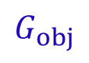
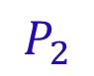
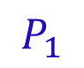
Our Goal: To Deliver the Minimally Required RF Power
Achieve the required goodput with the minimum RF power
Power Adaptation to different channel conditions
Correlation between goodput and transmit RF power in different channels
RF Power should be precisely adapted to channel conditions
Good channel
$$G_{obj}$$
Can we use neural networks to do the job?
Fair channel
Goodput
Bad channel
$$P_{1}$$
$$P_{2}$$
RF Power
Notes:
Based on this vision, [x] our goal is to achieve the required goodput with the minimum RF power from the reader, [x] and such RF power should also adapt to different channel conditions [x] because the channel condition affect the proportional relationship between the RF power and the goodput. For example, in the illustration, given a user specified goodput objective [x], the minimum RF power [x] should be P1 [x] and P2 [x] for good channel and fair channel, respectively.
[x] We want such power adaptation in different channels to be precise, [x] can we use neural networks to achieve this?

Slide 6

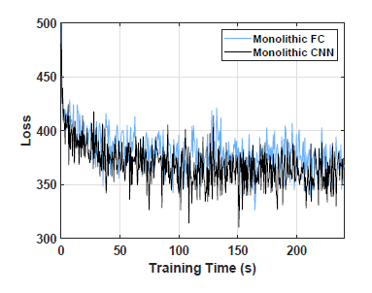
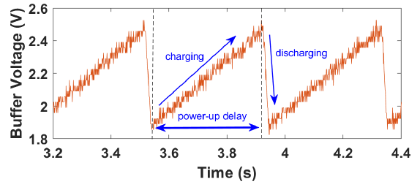
Power Adaptation using Neural Networks (NNs)
Highly variant backscatter channels
Sufficient channel measurements are required to train a monolithic NN
Training data are limited in practice
Backscatter throughput is low (<1Mbps)
~1 kbps for computational backscatter tags
Monolithic NN
Required Goodput
RF Power
Channel measure-ments
Extremely low duty cycle
> 80 hours to collect 10k data!
Poor convergence!
Notes:
[x] To train a monolithic NN for power adaptation, [x] sufficient channel measurements should be collected to overcome randomness and possible bias in training. This is because the backscatter signal is essentially a reflection of the reader’s signal. Such back-and-forth makes backscatter channels highly variant in practice.
However, [x] backscatter systems are natively low-speed. [x] Especially for computational backscatter tags, [x] the real-world goodput is further constrained by their extremely low duty cycles. As a result, [x] only a very limited amount of data can be collected within a reasonable amount of time.
[x] With limited training data, [x] the monolithic neural network experiences poor convergence in training due to learning confusions.

Slide 7
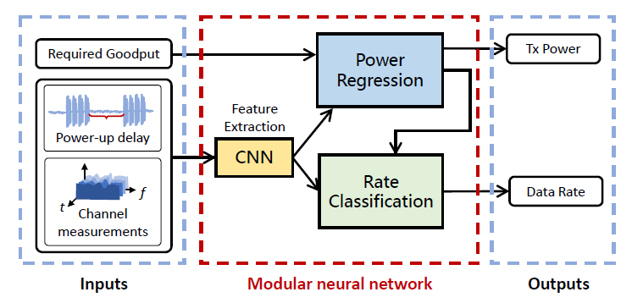
A Better Design: Modular Neural Network
Depict causal relationships between backscatter variables and channel conditions
Required goodput
Minimum RF power
Optimal Rate
Low
High
Good channel
Identify current channel conditions
Channel condition metrics
Optimal data rate
Required goodput
Goodput
Optimal rate
Bad channel
Minimum RF power
RF Power
Eliminate learning confusions over limited data
Avoid redundant interconnections
Notes:
Instead, we adopt a modular neural network design to overcome the learning confusion caused by the limited amount of training data. Compared to monolithic structures, our modular design aims to depict the causal relationships between backscatter variables and channel conditions.
[x] To conduct such causal inference, First, [x] the NN should identify the current channel condition [x] using the channel condition metrics. And then [x], given a required goodput, [x] we can infer the minimally required RF power to achieve such goodput under the current channel condition. Furthermore, [x] based on the RF power and channel condition, we can decide the optimal data rate being used in this case.
[x] We construct our modular neural network to reflect this causal diagram. [x] Such domain-specific modularization makes inference easier and eliminates the learning confusions over limited data and [x] avoids redundant interconnections. More details will be presented in later slides.

Slide 8
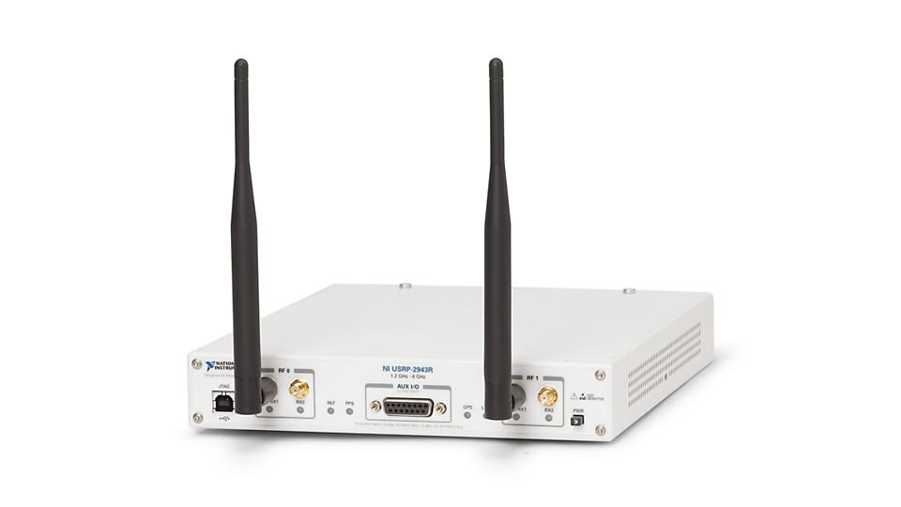
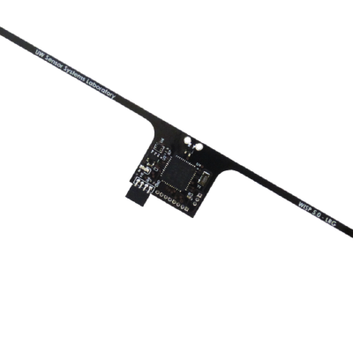
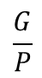
RAScatter System Overview
RAScatter – Reader Adaptation in Backscatter
Optimal RF Power
Required Goodput
Power regressor
Optimal Rate
Goodput (G)
$$\frac{G}{P}$$
Backscatter channel metrics
Feature extraction
Feature weighting
Energy eff.
Rate classifier
Channel Probing
RF Power (P)
Modular Neural Network
Energy Efficiency Optimizer
Decide the RF power and optimal rate
Iterative energy efficiency optimization
From normal transmission
Notes:
To this end, we present RAScatter – (reader adaptation in backscatter) that optimizes the reader’s energy efficiency using a modular neural network [x]. We restrain all RAScatter’s operations at backscatter readers, and require neither extra computation nor hardware change on batteryless devices.
Given the required goodput and channel condition metrics being probed from normal transmissions at runtime, [x] the modular neural network predicts [x] the minimum required RF power and the optimal data rate.
Based on these decisions, [x] an energy efficiency optimizer [x] iteratively queries the NN [x][x][x] to find the optimal setting that maximizes energy efficiency [x]. Eventually, the optimal RF power and the rate [x] will be applied to the reader.

Slide 9
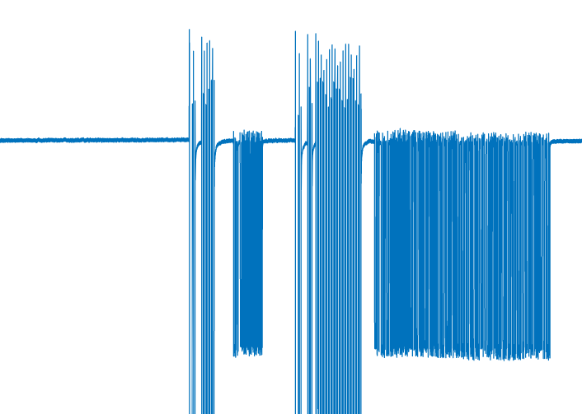
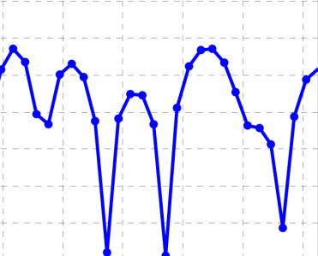
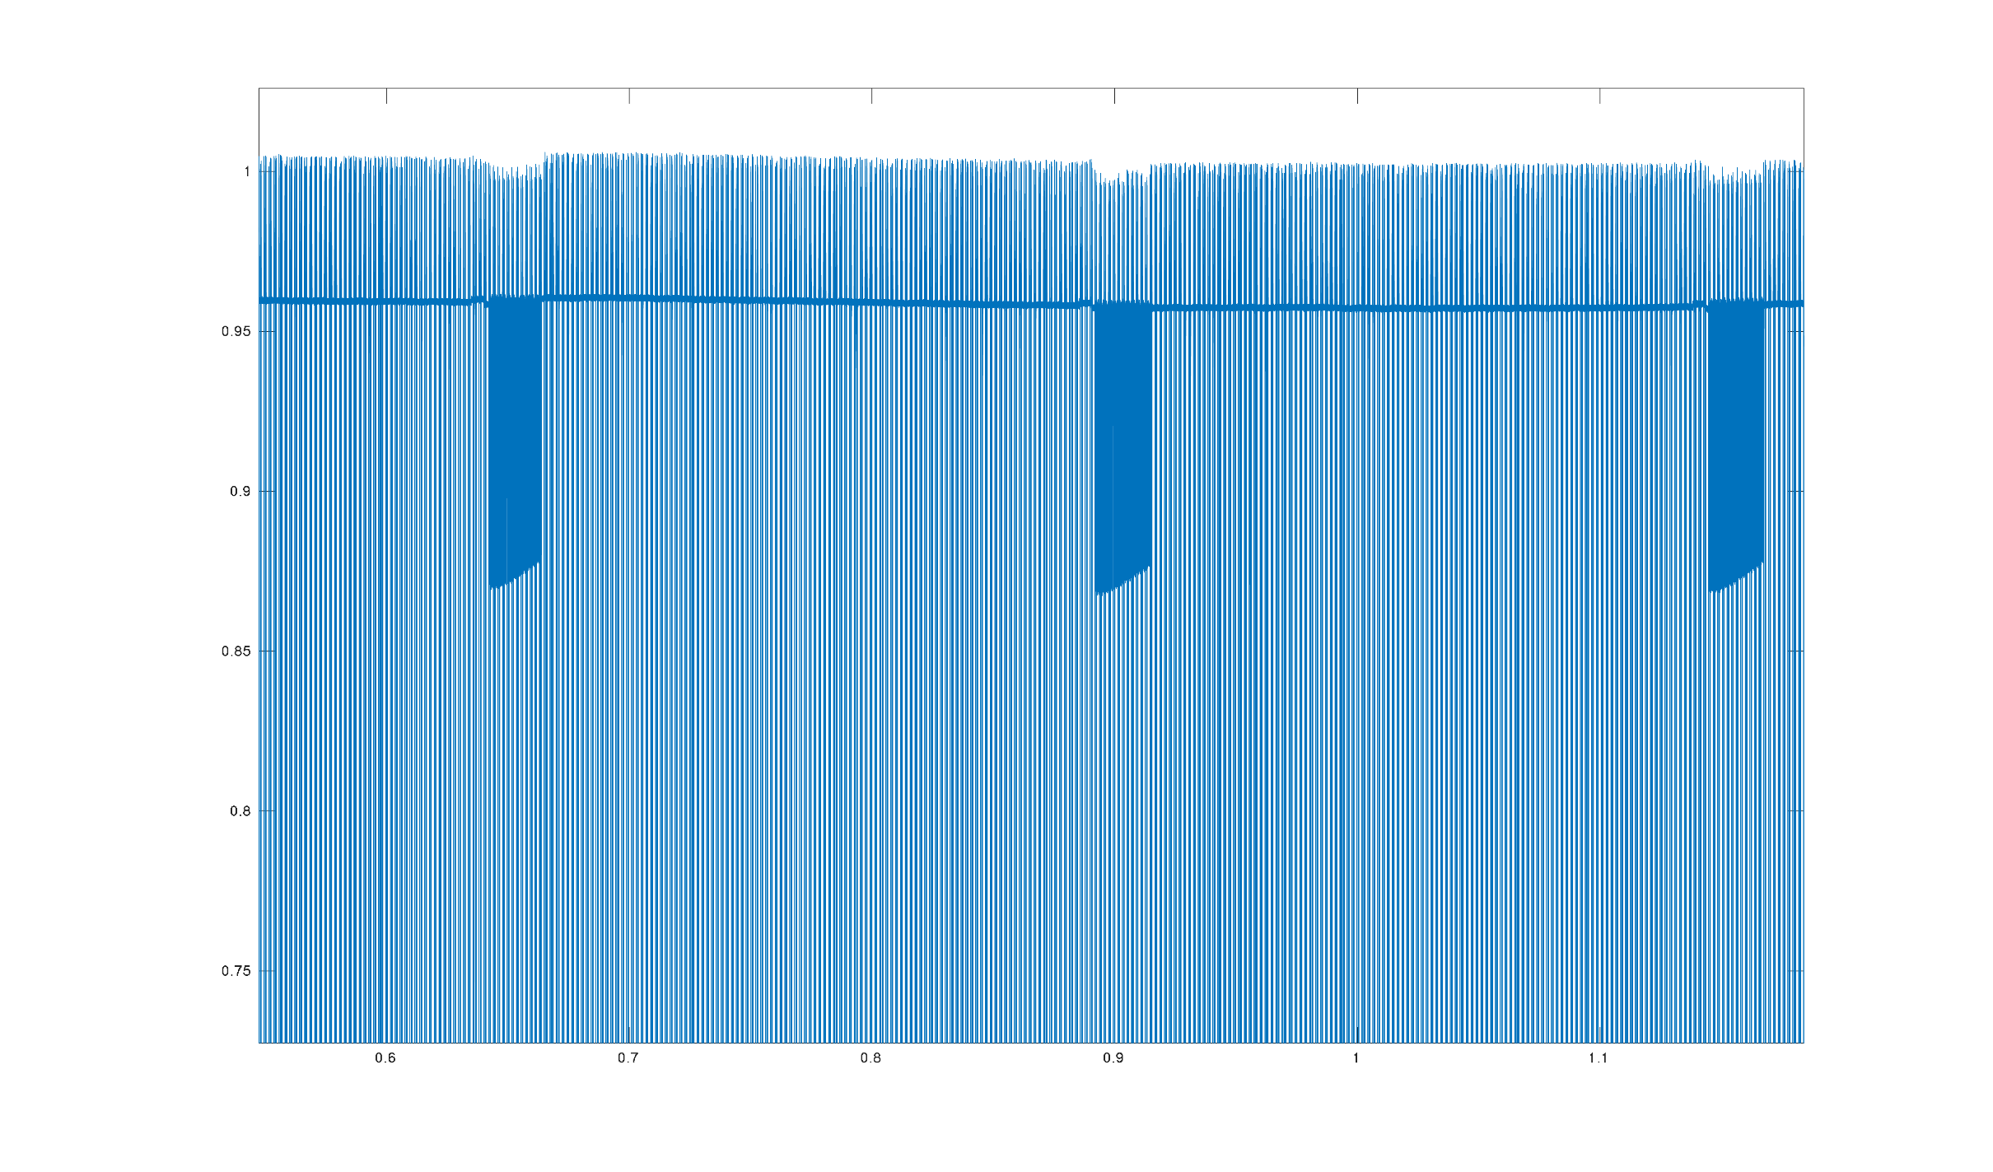
Probing Backscatter Channel Conditions
Channel condition metrics
Channel frequency response computed from standard preambles
Received signal strength (RSS)
Noise level excluding reader signals
Power-up delay in each duty cycle
Training data collection
Increase Tx power from 0 to maximum by small levels
At every level, collect channel metrics, optimal data rate, achieved goodput
Channel frequency response
Noise level
RSS
Power-up delay
Signals received by the reader
(Tx power, optimal rate)
Output label
Achieved Goodput
Input objective
Notes:
RAScatter undertakes multiple channel condition metrics for power adaptation [x] [x], including channel frequency response [x] computed from the standard preambles in backscatter packets, received backscatter signal strength [x], noise level [x] and the tag’s power-up delay [x]. Probing these metrics helps the NN identify current channel conditions at runtime. To ensure timeliness and accuracy, the highest RF power and data rate are used for runtime probing.
After deciding the channel metrics, [x] to collect training data, we increase the reader’s Tx power from 0 to maximum by small intervals, at every level, the channel metrics, optimal data rate and the achieved goodput are recorded. Then in training, [x] the pairs of power and rate are served as output labels. [x] And the corresponding achieved goodputs are the input objectives.

Slide 10
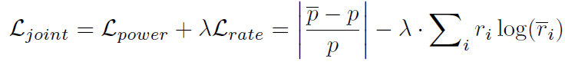
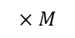
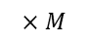
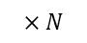
Modular Neural Network: sub-NN construction
Feature Extraction should not involve Required Goodput
Power Sub-NN and Rate Sub-NN focus on separated tasks
They undertake the same features
Interconnection required: The optimal rate depends on the power level
Power Sub-NN
Required Goodput
$$×M$$
Minimum Required RF power
Power-up delay, RSS, Noise
Linear
$$×N$$
Channel freq. response
Conv.
$$×M$$
Optimal data rate
Linear
softmax
Feature Extractor
Rate Sub-NN
Power regression error
Rate classification error
Notes:
After the training data is collected, we are prepared to design the modular neural network in detail for efficient training.
First, [x] the feature extraction procedure is independent of required goodput.
Second, [x] two sub-NNs are separately responsible for deciding the RF power and optimal data rates, based on the same feature inputs.
In particular, since the optimal data rate depends on the RF power being used, [x] the predicted power from the power sub-NN is forwarded to the Rate sub-NN input by concatenation.
After deciding the functionality of each module and the interconnections, we construct the feature extractor by stacking multiple convolutional layers, and the two sub-NNs with fully-connected layers.
[x] All the modules are jointly trained with standard loss functions to minimize power regression [x] and rate classification [x] errors.

Slide 11
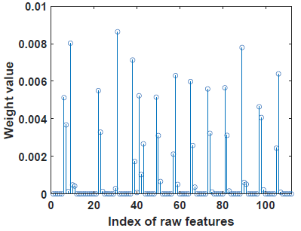
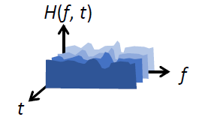
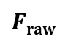


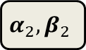
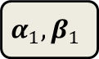
Modular Neural Network: feature weighting
Reduce learning ambiguity caused by irrelevant features
Help Power and Rate Sub-NNs focus on important features
Reduces error of power regression and rate classification by 6% and 5%
$$S$$
scaling + softmax
$$α_{1}, β_{1}$$
raw features
weights
CNN
$$Fraw$$
Channel frequency response
$$α_{2}, β_{2}$$
weighted features
Only a few important features are enhanced
$$D$$
encoded features
Notes:
Although the modular design reduces the learning difficulty with limited data, the training can also be biased by irrelevant channel features and lead to low accuracy of NN predictions.
To address this, RAScatter further adopts a learning-based feature weighting scheme to enhance the prominent features.
Specifically, [x] the raw features are projected [x][x] into weights and encoded feature space with trainable parameters [x], the weighted features are then used for power and rate predictions. The parameters of feature weighting are jointly trained with other modules using standard stochastic gradient descent algorithms. [x] Our experiments show that, the produced weights are skewed, and many irrelevant features are screened out, [x] thus the prediction accuracy improves .

Slide 12
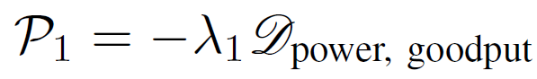
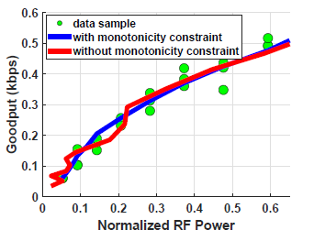
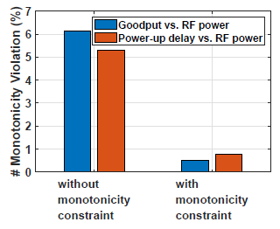
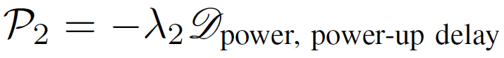
Adding Monotonicity Constraints to Training
The NN should retain monotonicity relations in backscatter systems
Given a required goodput:
Higher RF power -> Higher achieved goodput
Power-up delay is Longer -> need Higher RF power
Given limited training data, monotonicity could be violated!
Adding such penalties to the loss function
Notes:
On the other hand, with insufficient training data, the NN may not be able to generalize in a reasonable way over untrained data.
Particularly, the NN should always obey the following monotonicity constraint in backscatter systems:
[x] Given a required goodput, [x] higher RF power leads to higher achieved goodput. [x] And if the power-up delay becomes longer, the reader needs higher RF power to maintain the required goodput.
[x] Given limited training data and insufficient training, such monotonic relations could be violated. To address this, [x] during training, RAScatter examines if such monotonicity is violated on training data by computing derivatives of the corresponding quantities. [x] If any violation found, penalties would be added to the loss function for updating NN parameters. [x] Our experiments show that our monotonicity penalties can effectively suppress the violation cases.

Slide 13
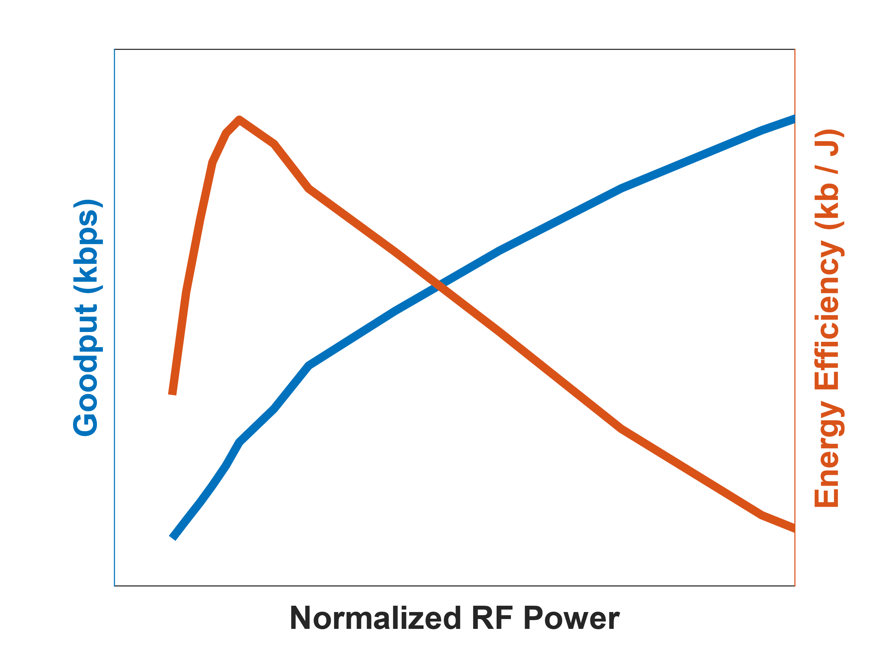
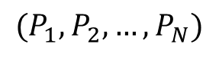

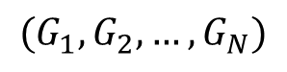

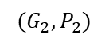
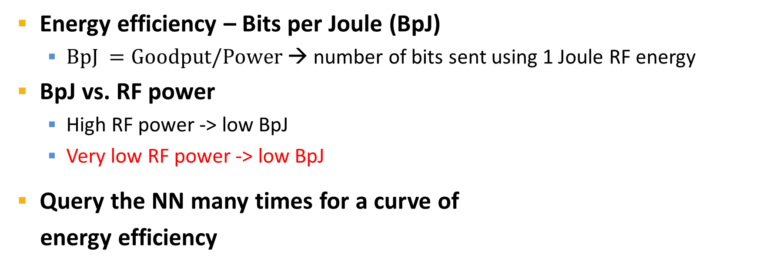
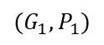
Low RF Power $≠$ High Energy Efficiency!
Energy efficiency – Bits per Joule (BpJ)
$BpJ =Goodput/Power$→ number of bits sent using 1 Joule RF energy
BpJ vs. RF power
High RF power -> low BpJ
Very low RF power -> low BpJ
Query the NN many times for a curve of
energy efficiency
Low P
High P
See theoretical proof in our paper
Goodput (G)
Energy Efficiency (G/P)
Transmit RF Power (P)
Goodput (G)
$$(G_{1},G_{2}, …,G_{N})$$
Power sub-NN
$$(P_{1},P_{2}, …,P_{N})$$
$$…$$
$$(G_{2},P_{2})$$
$$(G_{1},P_{1})$$
Transmit RF Power (P)
Notes:
Our previous designs all focus on reducing RF power, but it doesn’t ensure to maximize energy efficiency.
[x] In practice, the energy efficiency can usually be measured in the number of data bits being delivered using 1 Joule of RF energy. It’s also called BpJ as the ratio of the goodput to the power.
[x] Intuitively, reducing RF power [x] improves energy efficiency, however, [x] when the RF power is very low, the batteryless device can barely be powered up, and thus the energy efficiency can be dropping. [x] (The theoretical proof about these trends can be found in our paper)
In particular, the second case happens when the user specifies a very low goodput objective. In this case, to further improve the energy efficiency, [x] a straightforward solution [x] is to query the NN many times [x] to form a energy efficiency curve and find the optimal power and rate settings [x]. But this requires many times of NN inference so it’s very slow. Instead, we develop an iterative algorithm to decide the optimal Tx power and data rate that maximizes the energy efficiency with the minimum computational overhead. Due to the time limit, I will not introduce the details of this optimization algorithm, but please refer to our paper.

Slide 14
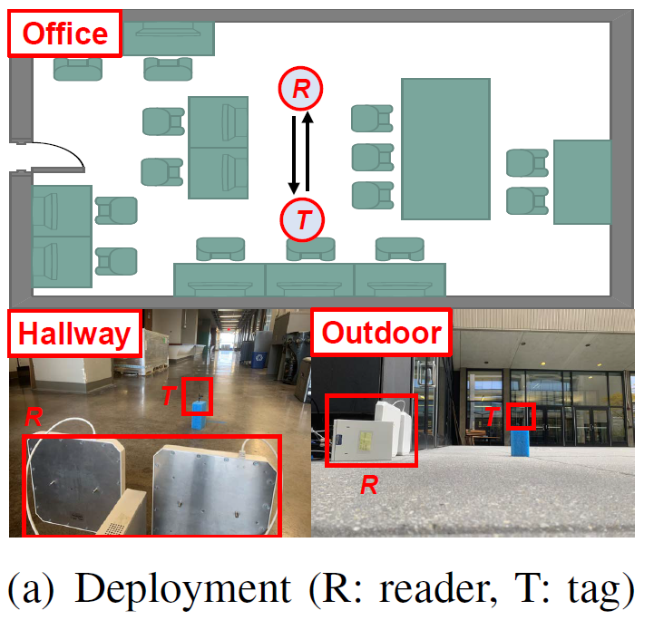
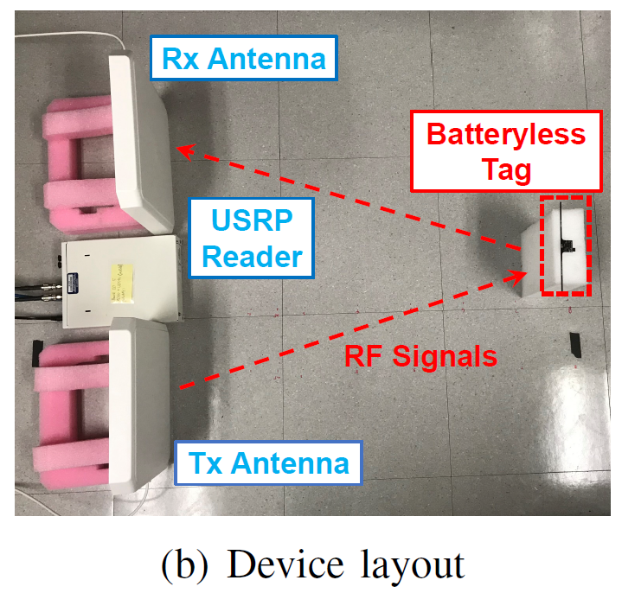
Implementation & Evaluation Setup
Backscatter device
WISP 5.1 batteryless tag (915MHz)
On-device temperature sensor
Assembly code for multiple data rates 160/80/40/20kbps
Backscatter reader
USRP N210 with SBX-40 daughterboards
Connect to Raspberry Pi 3 for NN inference
Evaluation settings
Office, hallway, outdoor scenarios
Various system factors and required goodputs
Rate adaptation as baselines
BLINK [1]: use RSSI and packet loss
MobiRate [2]: use packet loss and mobility estimation
Metrics: accuracy, energy efficiency (BpJ), delay
[1] P. Zhang, J. Gummeson, and D. Ganesan. Blink: A high throughput link layer for backscatter communication. ACM MobiSys, 2012.
[2] W. Gong, S. Chen, J. Liu, and Z. Wang. Mobirate: Mobility-aware rate adaptation using phy information for backscatter networks. INFOCOM, 2018.
Notes:
We implement RAScatter as an end-to-end system using WISP batteryless tags and a USRP reader.
Particularly, the firmware of the original wisp tag doesn’t support multiple data rates, so we use assembly code to implement more data rates. Please noted that our implementation is generic and most of the commodity backscatter devices should support multiple data rates for basic rate adaptation.
We evaluate RAScatter’s performance in various indoor and outdoor scenarios and include multiple system factors into our evaluation. We choose the state-of-the-art schemes BLINK and MobiRate as baselines for comparison. These two existing rate adaptation baselines are specifically designed for backscatter communication. In our experiments, we measure the power adaptation’s accuracy, energy efficiency and delay for comparison.

Slide 15
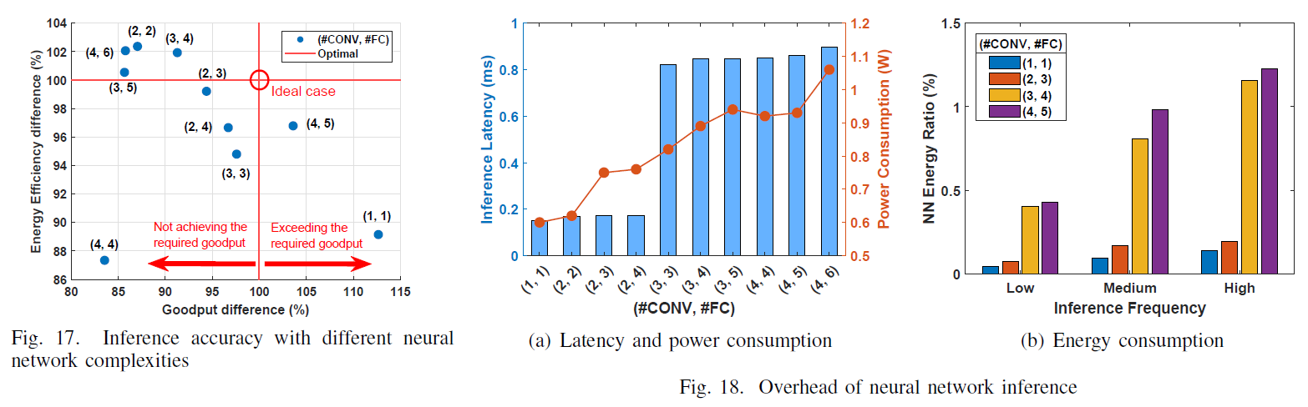
Neural Network Complexity
NN inference latency < 1ms
NN model size < 1MB
NN energy < 1.5% of RF energy
RAScatter’s modular neural network is lightweight!
Notes:
We first investigate the system overhead of our modular neural network by varying the number of network layers.
According to our results, RAScatter’s latency of neural network inference on Raspberry Pi 3 is generally lower than 1ms, and the energy consumption of such inference is <1.5% of RF energy consumption even with the highest inference frequency, that is 10 times per second.
[x] Therefore, RAScatter is lightweight and affordable on most portable backscatter readers.

Slide 16
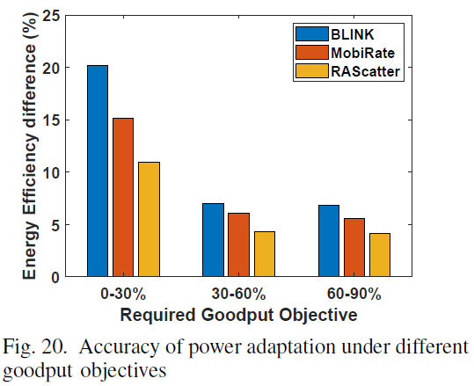
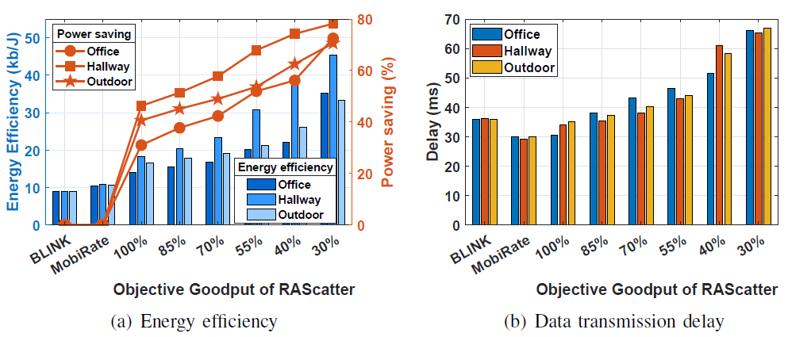
Performance of Power Adaptation
Power adaptation accuracy > 95%
Energy efficiency improves by up to 3.5x
Battery saving by 78%
Power adaptation is accurate and effective!
Notes:
We then compare RAScatter’s power adaptation performance with baseline schemes using different required goodputs. For cases of BLINK and MobiRate in these experiments, we manually reduce the reader’s RF power from the maximum to exactly achieve the goodput objective. We find that RAScatter’s power adaptation is more accurate. The energy efficiency achieved by RAScatter is very close to the optimum.
Due to high accuracy, in office, hallway and outdoor scenarios, RAScatter improves energy efficiency by up to three and half times and saves the backscatter reader’s battery by up to 78%. Although RAScatter also incurs moderate delay increase, it can be effectively restrained to <10ms if the goodput objective is >50%.
[x] These results demonstrate RAScatter’s power adaptation is accurate and effective.

Slide 17
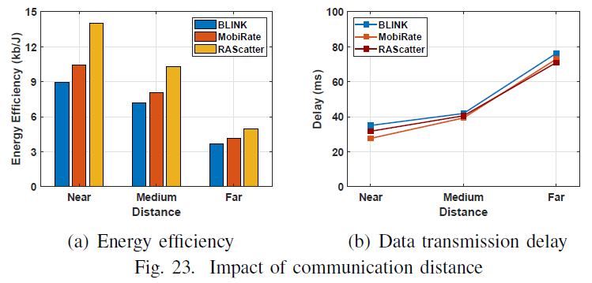
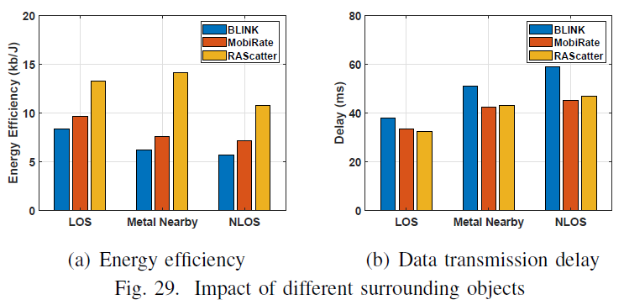
Impact of Distance and Surroundings
Different distances
Near (20-50cm), Medium (50-80cm), Far (80-120cm)
Energy efficiency improves by up to 1.5x
Only incurs < 10% delay increase
Different surroundings
Energy efficiency improves by up to 2x
Only incurs < 3% delay increase
Highly adaptive to different ranges and surroundings!
Notes:
In practice, the communication ranges and nearby metal objects can impact backscatter channels, and hence affect power adaptation. We further evaluate RAScatter at different ranges and with different surroundings settings, including line-of-sight, non-light-of-sight and with metal objects nearby. According to our results, RAScatter can still significantly outperform baseline schemes with 1.5 times energy efficiency improvement. [x] It demonstrates its high adaptivity in real world settings.

Slide 18
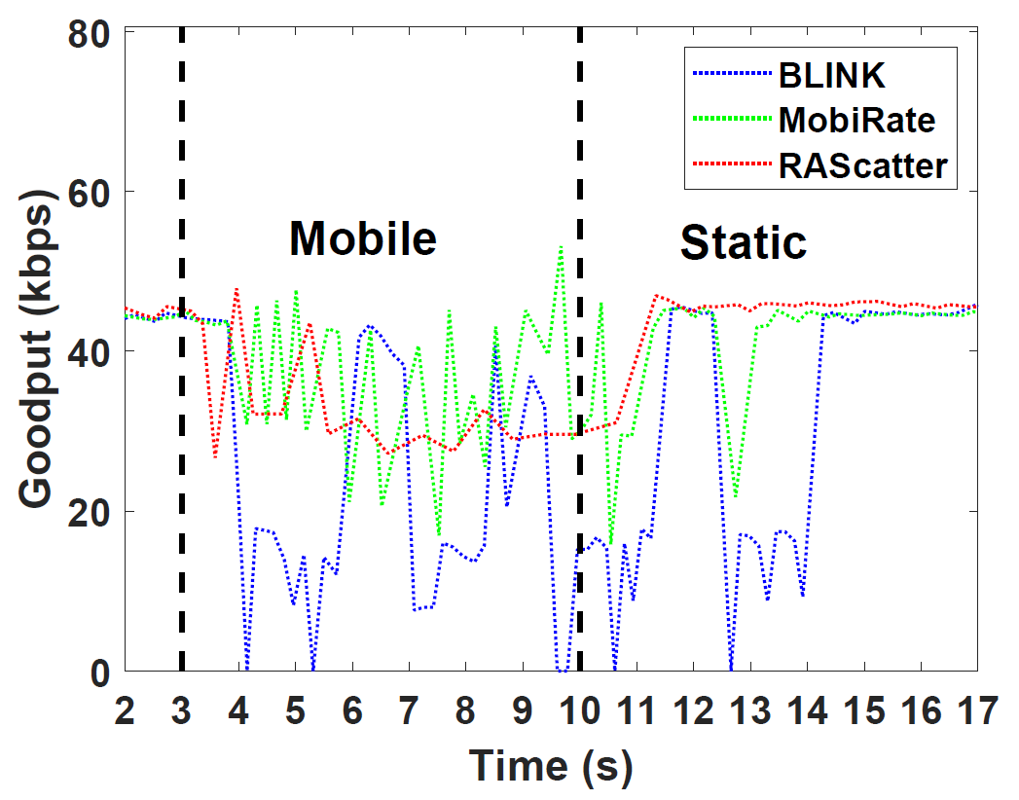
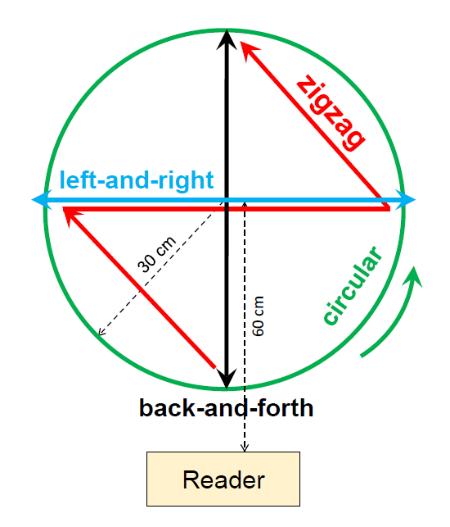
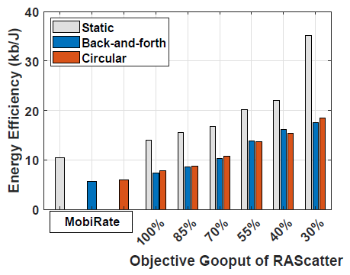
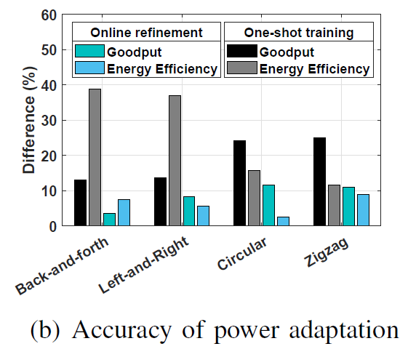
Impact of Device Mobility
Resilience to device movement
Reduce stabilizing delay by > 50%
Under different mobility patterns
Improves energy efficiency by up to 3.5x
Power adaptation accuracy > 90%
Robust to mobile scenarios!
Notes:
When the device is moving, the backscatter channel will be highly dynamic and impacts power adaptation. We particularly evaluate RAScatter’s performance with different device mobility settings.
[x] Specifically, we study the transition period of the reader from mobile to static. As shown in the right figure, [x] RAScatter shows high resilience to device movement [x] and reduces stabilizing delay [x] by more than half compared with baselines.
[x] Our experiment further shows that under various tag mobility patterns, [x] RAScatter can retain similar energy efficiency improvement and [x] power adaptation accuracy to static cases, [x] which demonstrates its robustness to mobile scenarios.

Slide 19
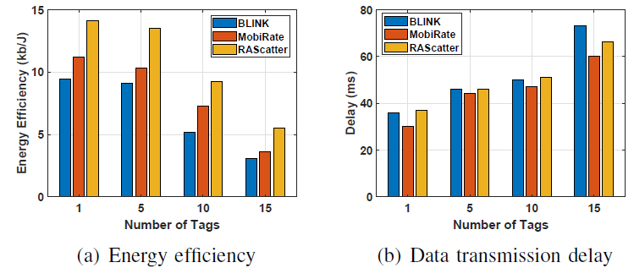
Performance with Multiple Tags
Improves energy efficiency by 1.3x to 1.5x
Only incurs < 10% extra delay
Notes:
In many sensing applications, such as temperature and gas density monitoring, there are usually many backscatter devices being deployed for the reader to retrieve sensory data.
To evaluate this case, we place up to 15 tags in random locations from the reader Our results show that RAScatter is still able to maintain high energy efficiency with only a small amount of delay increase, and hence demonstrates its scalability.

Slide 20
Discussion
Device heterogeneity
Power adaptation is affected by hardware (e.g., antenna sensitivity)
Train a unified NN with different device models
Transfer learning
Improve adaptivity to new environments
Channel probing is lagged by low backscatter throughput
Synthesize more data: Generative Adversarial Networks (GANs)
Faster adaptation: meta learning
Notes:
Beyond our work, we suggest that RAScatter’s performance can be improved from two perspectives:
First, the device hardware, such as antenna sensitivity and buffer capacity, can affect power adaptation. A feasible solution to addressing this, is to train a unified NN with data being collected from different device models. Or, use transfer learning for quick adaptation based on user’s demand.
Second, because backscatter systems are typically low-speed, channel probing can be slow that delays power adaptation. To improve timeliness, generative models such as GANs can be used to quickly synthesize more channel measurements, and meta learning can also help with online faster adaptation.

Slide 21
Summary
Power adaptation for energy-efficient backscatter readers
Achieve the required goodput with minimum required RF power
Extend the battery life of mobile backscatter readers
A modular neural network design
Depict entangled correlation between backscatter channel, RF power, and goodput
Minimize redundancy and learning bias
RAScatter improves energy efficiency by up to 3.5x
Practicality
Lightweight NN inference
No hardware modifications
Apply to most of commodity batteryless tags
Notes:
To summarize, in this work, we present RAScatter, a new backscatter system that enhances the energy efficiency of backscatter readers by adapting the reader’s transmit RF power to the required goodput. RAScatter aims to alleviate the high energy cost of mobile backscatter readers and extend their battery life. It allows users to flexibly balance between energy efficiency and timeliness of backscatter communication, based on the application requirements.
Second, we propose a modular neural network design that depicts domain relationships in backscatter systems. It ensures efficient training over limited training data and thus improves energy efficiency by up to three and half times.
Finally, RAScatter is lightweight and generic. It requires no hardware modifications and can be applied to most of commodity backscatter devices.

Slide 22
Thank you!
Notes:
This is the end of my talk. Thank you for watching and please refer to our paper for more details.

Slide 23
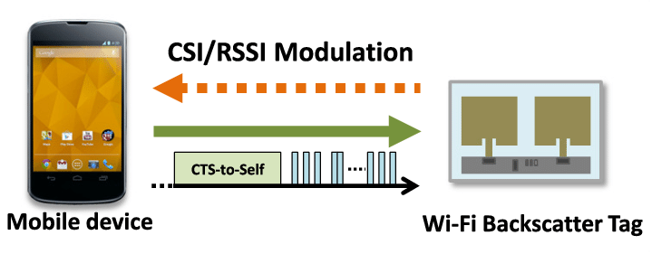

Existing Approaches to Saving Reader’s RF Energy
Saturation won’t happen on computational tags!
Power scaling to avoid saturation
Limited to traditional RFID & NFC
Offline scaled for fixed channels
Or exhaustive search at runtime
Rate adaptation
Doesn’t reduce RF power
Inaccurate channel metrics
RFID & NFC only!
Saturated
Goodput
$$P_{min}$$
RF Power
Low adaptivity & high cost
RSSI, SNR, Packet loss
# bits to be sent
Low accuracy & limited energy saving
Optimal rate
Max. goodput
Min. RF emission time
Notes:
To save the reader’s RF energy [x], [x] early work reduces the reader’s RF power from the saturation zone, while it can still ensure maximal goodput. [x] However, saturation only happens in traditional RFID and NFC systems, [x] but doesn’t apply to other backscatter systems such as wifi backscatter. Plus, [x] such scheme either calibrates the RF power for fixed channel conditions [x] or exhaustively search the optimal power at runtime. Therefore, [x] this approach has low adaptivity and high cost.
[x] Alternatively, [x] rate adaptation tries to maximize goodput with the optimal rates, so that [x] given a fixed amount of data, [x] the reader spends minimal energy for transmission. However, [x] [x] it doesn’t reduce reader’s power [x] and the channel condition metrics cannot precisely reflect the impact of channels [x]. Therefore, [x] the energy saving is very limited, and the adaptation is inaccurate.

Slide 24
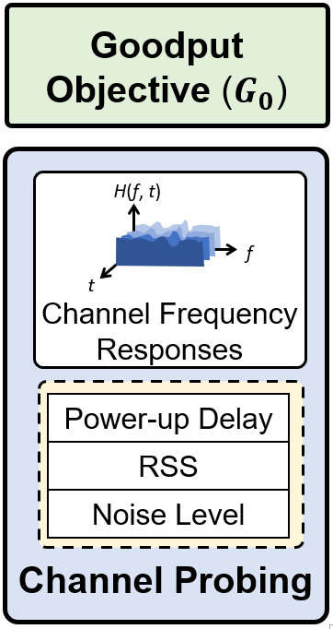
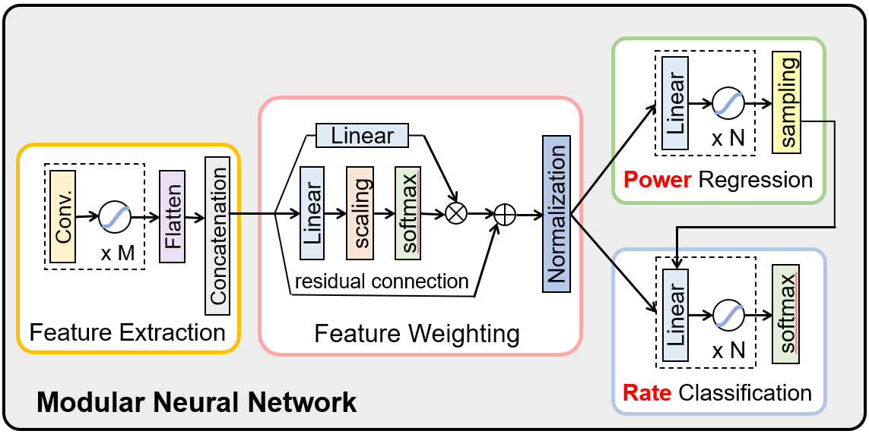
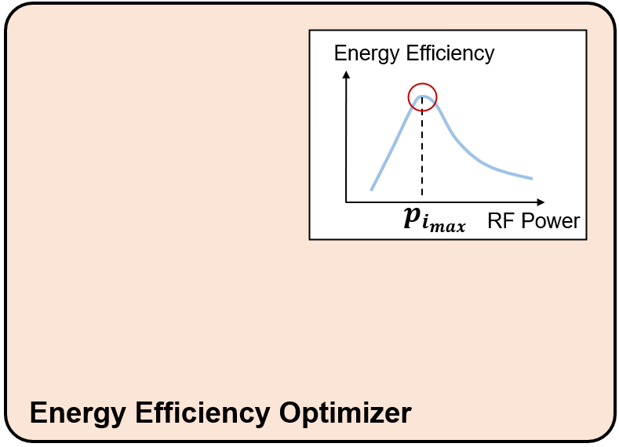






RAScatter System Overview
RAScatter – Reader Adaptation in Backscatter
Minimum RF Power ($p$)
Yes
Optimal Data Rate ($r$)
$$G_{i_{max}}>G_{0}$$
$G_{0}:$[$p_{0}$, $r_{0}$]
No
Predict Tx power and optimal rate
Iterative Energy Efficiency Refinement
Notes:
[draw three main blocks and hide details, later details of each block needs correspondence]
[motivations for energy efficiency optimizer can be provided here]
[slide 6 and 7 are the most important]
To this end, we present RAScatter – (reader adaptation in backscatter). Our RAScatter system is structured around the modular neural network.
Providing channel condition metrics at runtime, the modular neural network predicts the minimum required Tx power and the optimal data rate for the reader device. The optimal rate is to reduce transmission failures and ensure minimum RF emission time.
Based on the predictions, an energy efficiency optimizer iteratively queries the NN for more predictions for runtime refinement of energy efficiency.

Slide 25
A Better Design: Modular Neural Network
Decompose the NN inference procedure to represent the impact of channel conditions
Eliminate learning confusion over limited training data
Avoid redundancy from a monolithic NN
Task decomposition (into sub-NNs)
Retain only necessary interconnections
RAScatter’s modular neural network at a high level
Notes:
[need to explain what correlations in the physical world it represents, need to be more self-contained]
Instead, we adopt a modular neural network design to overcome the learning confusion over limited training data.
Compared to monolithic structures, we decompose the NN inference procedure into modules to represent the impact of channel conditions. Here is a high-level picture of our modular design, where the whole inference task is decomposed and specialized to different sub-NNs, and only necessary interconnections are retained. I will present the details in later slides.

Slide 26

Modular Neural Network: sub-NN construction
Feature Extraction should not involve Required Goodput
Power Sub-NN and Rate Sub-NN focus on separated tasks
They undertake the same features
Interconnection required: The optimal rate depends on the power level
Required Goodput
Power Sub-NN
Minimum Required RF Power
Channel Condition Metrics
Feature Extractor
Rate
Sub-NN
Optimal Data Rate
Power regression error
Rate classification error
Notes:
[explanation for loss functions is needed with annotations]
After NN’s training data are collected, we prepared to design the NN in a modular manner for efficient training.
We plot our collected data and gain domain knowledge for modularization.
First, the feature extraction procedure is independent of required goodput
Second, the sub-NNs for power and optimal rate predictions specialize in separate tasks.
They undertake the same features. In particular, from the domain knowledge, the optimal rate depends on the power level, so the predicted power is forwarded to the rate sub-NN.
All the modules are jointly trained with standard loss functions for power regression and rate classification.

Slide 27




Online Model Refinement
Adapt to untrained channel conditions via online learning
No label -> supervised training is impossible
Use the current predictions and the goodput difference
Power minimization
Goodput difference minimization
Trigger when $ΔG>th$
Rate prediction likelihood
Power prediction likelihood
Goodput difference
Learning proceeds with $L_{online}$ via Stochastic Gradient Descent (SGD)
Notes:
To further ensure power adaptation accuracy in untrained scenarios, RAScatter enables online learning.
[x] However, the label is unavailable at runtime, so the supervised training is impossible. [x] Instead we use the current prediction states and the goodput difference to construct training feedback.
[x] Specifically, our online loss function reflects two goals, [x] one is power minimization using the current predicted Tx power, [x] another goal is to minimize the difference between the required and the achieved goodput. To compute such difference, [x] we use the prediction likelihood from the NN’s output [x] to multiply the relative goodput difference over a time interval. [x] The online learning is triggered when the goodput difference exceeds a threshold and [x] can then be conduct with SGD algorithms.
[x] Our experiment shows the online loss function can effectively improve reader’s power adaptation in untrained scenarios.

Slide 28











Energy Efficiency Optimizer
Reduce query times by incorporating analytical approximation
Check if BpJ can be improved
Begin with ${(G}_{0},P_{0})$
Query with $G_{0}+ΔG$ for $P_{1}$
Yes, if $EE^{′}>EE$
Goodput (G)
$$EE′$$
Energy Efficiency (G/P)
$$EE$$
Iteratively search max. BpJ
$${\tilde{S}}_{max}$$
$$G_{0}+ΔG$$
$$S_{2}$$
Solve $\left(a_{0},a_{1}\right)$ in ${G=a}_{0}\sqrt{P}+a_{1}$with $(S_{1},S_{2})$
${\tilde{S}}_{max}⁡←{argmax}_{S}(G/P)$
${(S}_{1},S_{2})←(S_{2},{\tilde{S}}_{max})$
Repeat from 1 to 3
$$G_{0}$$
$$S_{1}$$
analytically
$$P_{0}$$
$$P_{1}$$
Transmit RF Power (P)
Experimentally achieve convergence with < 5 queries
Notes:
Instead, we incorporate the analytical approximation and iteratively find the optimal Tx power and data rate.
[x] First, RAScatter checks if the required goodput is too low and if BpJ can be improved [x].
[x] Starting after the first query [x], RAScatter increases the required goodput a bit [x] and queries the NN again [x], [x] if the derived energy efficiency improves, then it will proceed to finding the optimum [x][x].
[x] Given the two states S1 and S2 already known, [x] we analytically approximate a BpJ curve using backscatter theory [x] [x] [x] [x], and then find the optimum state [x], which forms are new pair of states [x] for the next iteration [x].
[x] We experimentally demonstrate our optimizer can achieve convergence within 5 queries and find the optimal tx power and rates.

